Slide 1


USED CAR SALE
EXPLORATORTY DATA ANALYSIS (EDA)
PRIYA DAVIS

Slide 2
Framework :
Problem Statement
Choose right tools
Collection of data
Data Pre-Profiling
Data Pre-Processing
Data Post-Profiling
Ask Right Questions
Summarization / Observations
Actionable Insights
Data Exploration

Slide 3
Problem Statement:
An American Car company buys and sells secondhand cars.
The company has earned its name because of sincerity in work and quality of services.
But for past few months their sales declined.

Slide 4
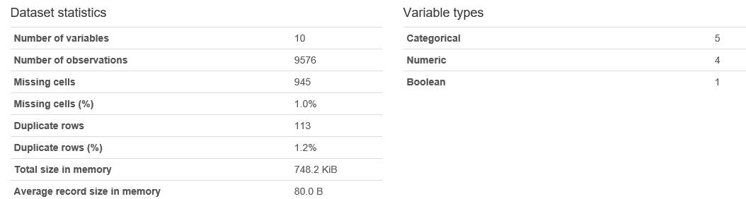
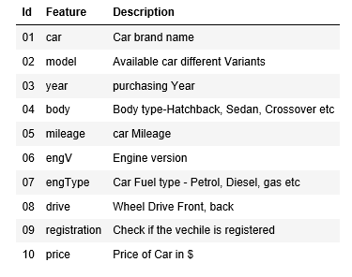
Introduction to Data:
Pre-Profiling Report

Slide 5
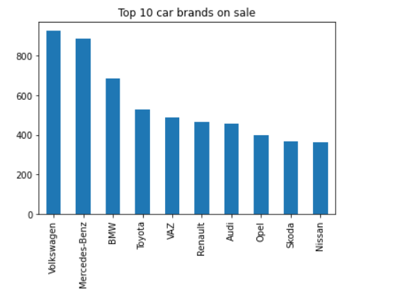
Data Exploration:
Volkswagen is highest selling brand followed by Mercedes Benz

Slide 6
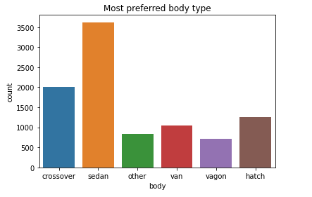
Data Exploration:
Which cars are sold maximum and minimum based on type of body ?
Sedan cars has highest sale followed by crossover, vagon is the least sold car model.

Slide 7
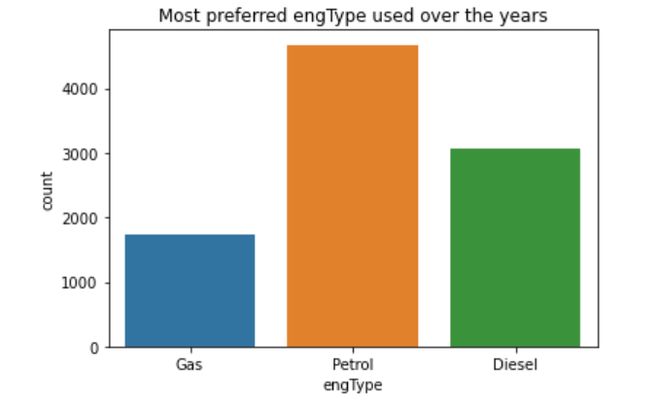
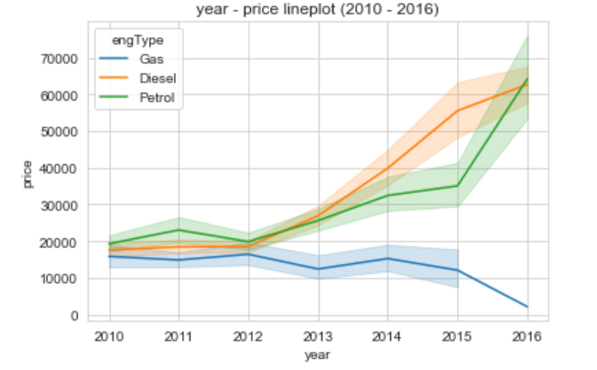
Data Exploration:
Car sales based on Engine type
Car prices based on Eng type
Cars with petrol engine are sold highest and with gas are least sold.

Slide 8
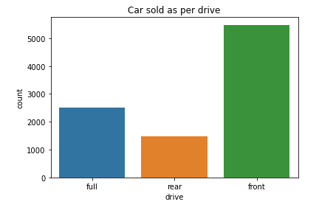
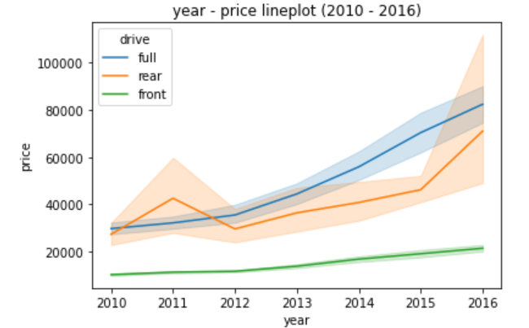
Data Exploration:
Car sales based on Drive
Car prices based on Drive
Front wheel drive cars are sold highest and rear wheel drive are least sold.

Slide 9
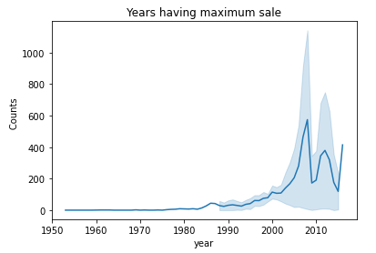
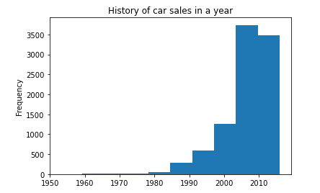
Data Exploration:
When is the maximum numbers of car sold ?
The above graph indicates least sale of cars is between 1953 and 1982 (approx).
Highest sale of cars is between 2000 and 2010, and seems to be in 2008

Slide 10
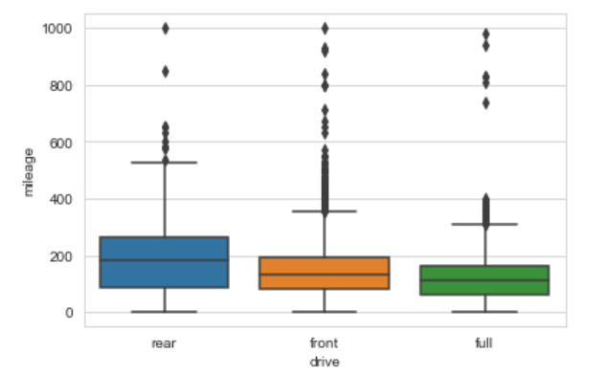
Data Exploration:
Box plot represents relation between mileage and drive.
There are few outliers which can be ignored.

Slide 11
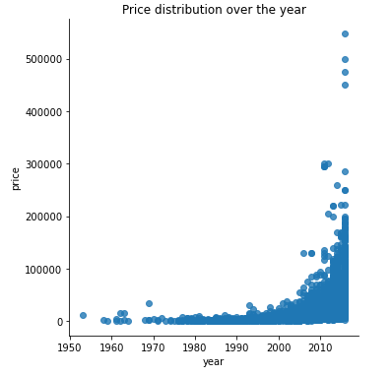
How much is increase in price of car with respect to year?
Price of Car is low between 1953 and 1995 , price has gradually increased from year 2000.
There are some outliers from 2007 (approx.) onwards. After 2011, the prices have increased very high.

Slide 12
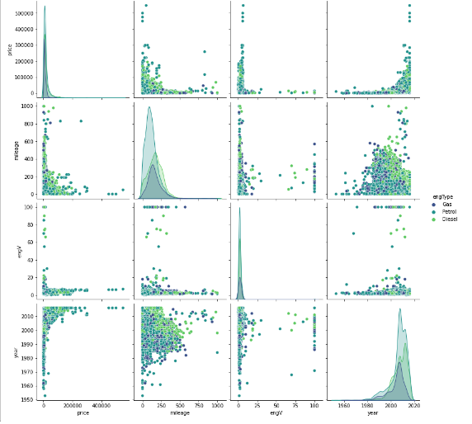
Corelation Matrix
Price of Car is low between 1953 and 1995 , price has gradually increased from year 2000.
There are some outliers from 2007 (approx.) onwards. After 2011, the prices have increased very high.

Slide 13
Observations:
Volkswagen, Mercedes make i.e Premium cars are more popular.
Sedan and crossover body types are more preferred than other types.
Most sales are in the price range of 10k to 40k.
Petrol Cars are more preferred than diesel. Less acceptance to gas engine.
Front drive vehicles sale is more because of its good mileage.

Slide 14
Actionable Insights:
To increase the sale of cars, price range should be less than 15K.
Procure sedan cars having petrol engine and front drive as these are having more demand.
Less preferred cars or too old cars should be Liquidated by giving some discounts so that stock can be cleared.
Provision to make non registered vehicles registered will boost sale.
Less acceptance to gas engine, so those cars can be converted to diesel/petrol engine.

Slide 15
THANK YOU !!

